Slide 1
BANKING MANAGEMENT SYSTEM
Under the Guidance of ,
Mrs. Indrakka Mali Mam
Submitted BY,
Prashanth S
Sreeja M
Suma M R
Sudha R
Kushal Sharma M

Slide 2
Introduction
The bank management system is an application for maintaining a person’s account in a bank.
The system provides the access to the customer to create an account, deposit and withdraw the cash from his account, also to view reports of all accounts present.
The following presentation provides the specification for the system.

Slide 3
Modules:
Account Module
Customer Module

Slide 4
Software Requirements
Spring boot
MySQL
Postman
Hardware Requirement
Windows 10 or above
RAM :4GB or above

Slide 5
Annotations Used :
1.@Entity
Creates Table
This annotation specifies that the class is an entity.
Specifies The Table Name
This annotation specifies the Table in the Database with which this Entity is mapped.
2. @Table
3.@Id
This annotation Generates Primary Key of the entity.
Each JPA entity must have a primary key that uniquely identifies it,
The @Id annotation defines the primary key.
4.@Not Blank
This annotation specifies That string is not null and the trimmed length is greater than zero
5.@Column
@Column annotation is used for Adding the column name in the table of a particular MySQL database.
6.@Rest Controller
Allows the class to handle the requests made by the client
7.@Autowired
Auto wiring feature of spring framework enables Us to inject the object dependency implicitly.
It internally uses setter or constructor injection.

Slide 6
8.@GetMapping
It is used to handle GET type of request methods.
@Get Mapping annotated methods in the @Controller annotated classes to handle the HTTP GET requests matched with given URI expression.
9.@PutMapping
It is used to handle PUT type of request methods.
It is used to create a web service endpoint that updates a resource.
10.@DeleteMapping
It is used to handle DELETE type of request methods.
It is used to create a web service endpoint that deletes a resource.
11.@PostMapping
It is used to handle POST type of request methods.
It is used to create a web service endpoint that creates a resource.
12.@Repository
it also enables annotated classes to be discovered and registered with the application context.
13.@Query
The @Query annotation declares finder queries directly on repository methods.
14.@Path Variable
@PathVariable is a Spring annotation which indicates that a method parameter should be bound to a URI template variable.

Slide 7
15.@Transactional
metadata that specifies that an interface, class, or method must have transactional semantics
@Transactional annotation is used when you want the certain method/class(=all methods inside) to be executed in a transaction.
16.@Modifying
The @Modifying annotation is used to enhance the @query annotation so that we can execute not only select queries , but also Insert , Update , Delete , and even DDL queries.
17.@Service
It is used to mark the class as a service provider.
This annotation is used with classes that provide some business functionalities.
18.@Request Body
It is used to bind HTTP request with an object in a method parameter.
19.@Param
Query parameters are a defined set of parameters attached to the end of a url.
@QueryParam is used to access key/value pairs in the query string of the URL
20.@Controller Advice
@Component Annotation which allows to handle exceptions across the whole application in one global handling component.
21.@Exception Handler
The @ExceptionHandler is an annotation used to handle the specific exceptions and sending the custom responses to the client.

Slide 8
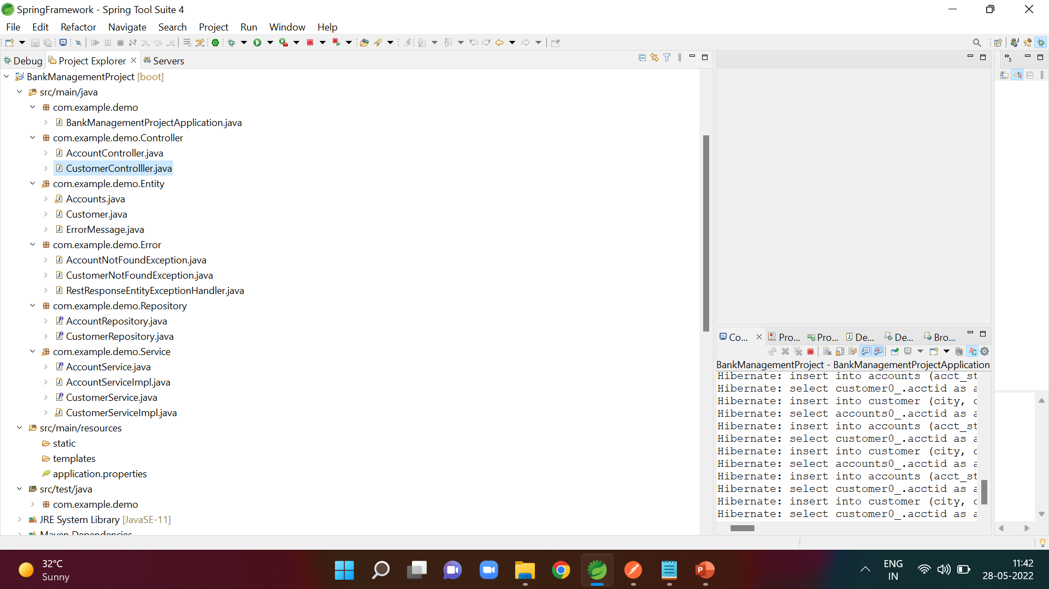
STRUCTURE OF THE PROJECT

Slide 9
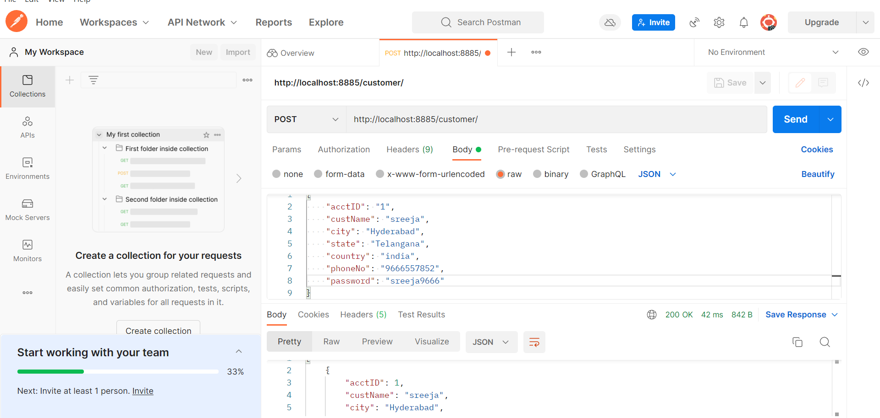
Inserting the customer values By Using POST Method
URL:http://localhost:8885/customer/

Slide 10
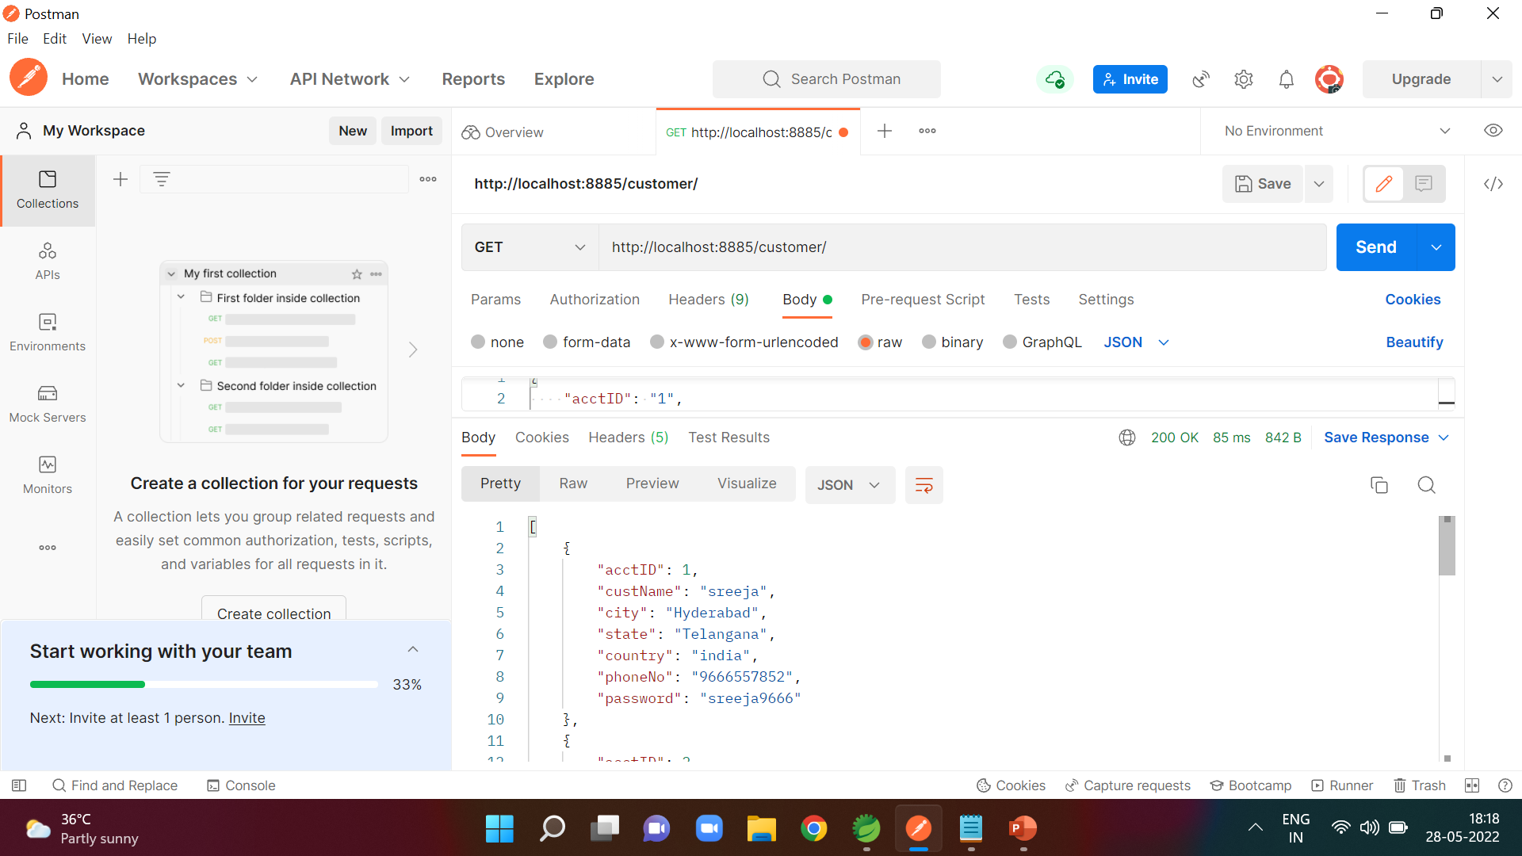
Display All of Customer using GET Method
URL:http://localhost:8885/customer/

Slide 11
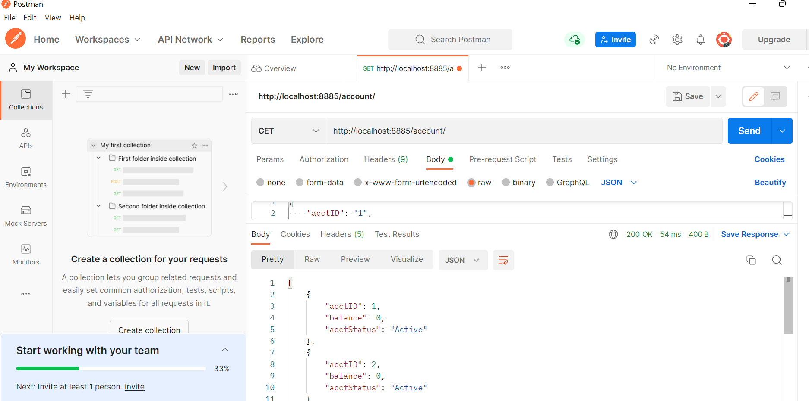
Display All Account Details using GET Method
URL:http://localhost:8885/account/

Slide 12
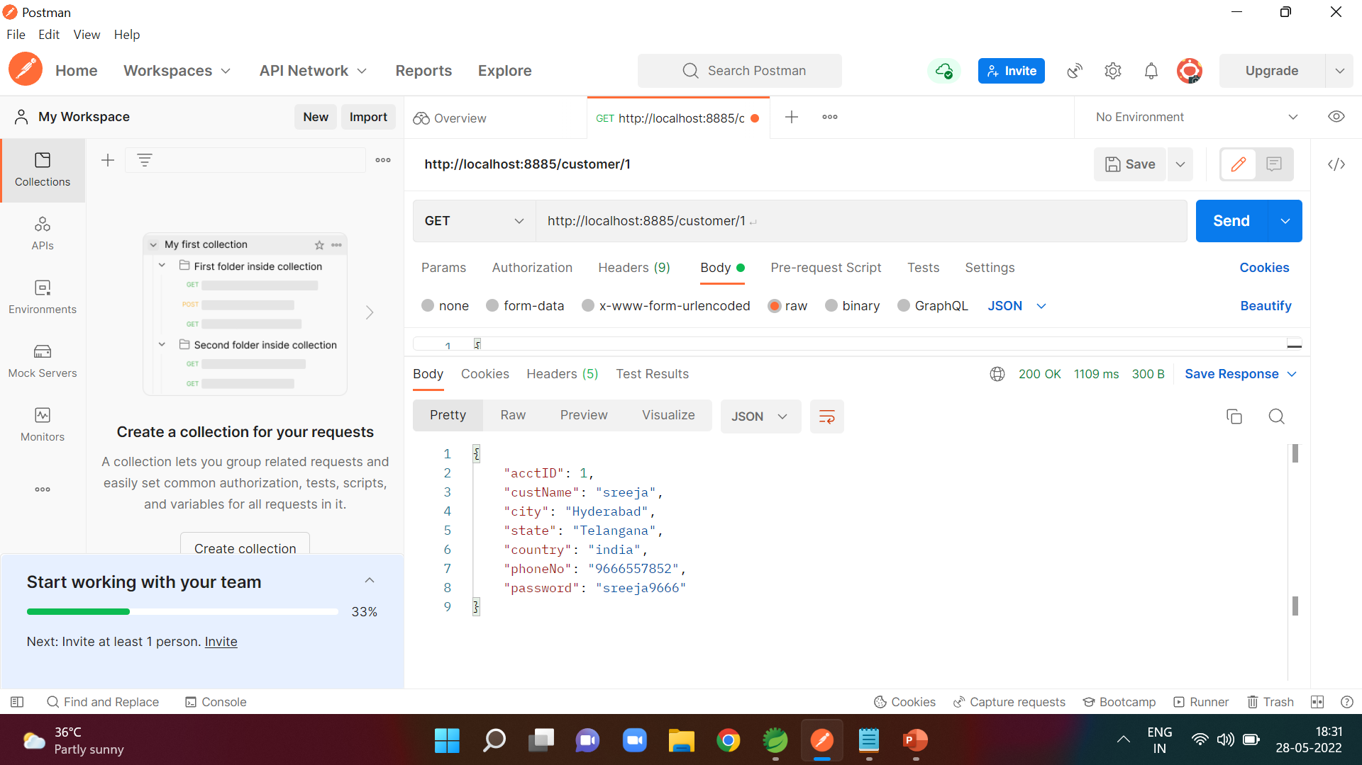
Display the details of customer based on id using GET Method
URL:http://localhost:8885/account/1

Slide 13
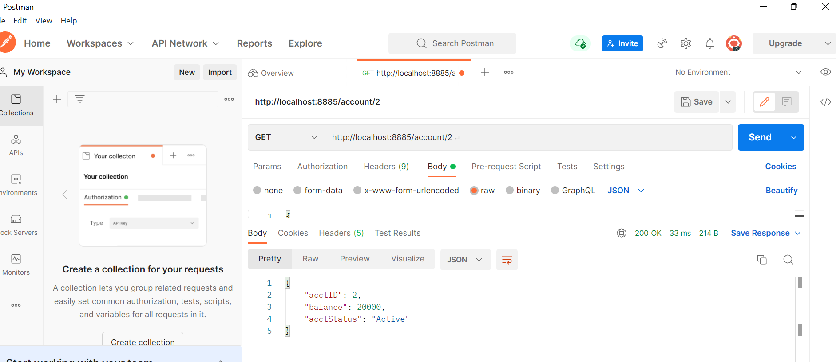
Display the details of Account based on id using GET Method
URL:http://localhost:8885/account/2

Slide 14
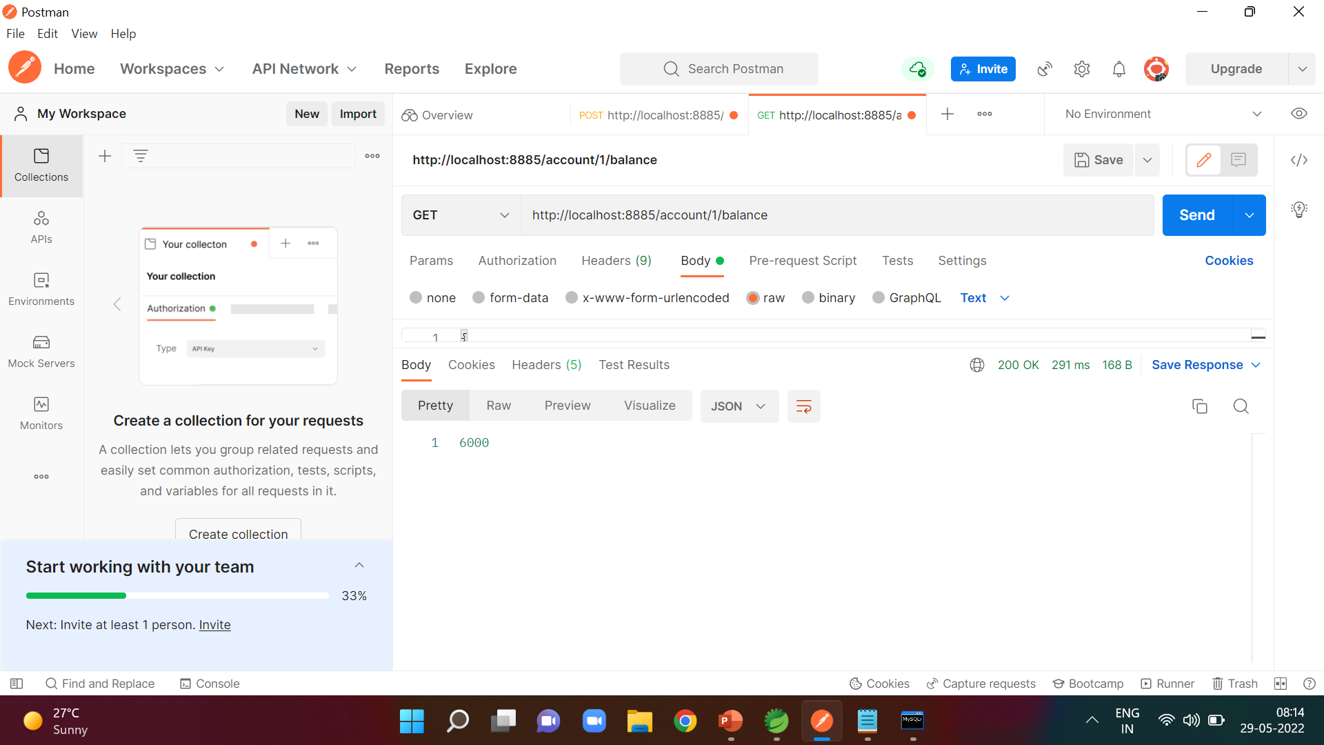
Display the balance of customer based on id using GET Method
URL:http://localhost:8885/account/1/balance

Slide 15
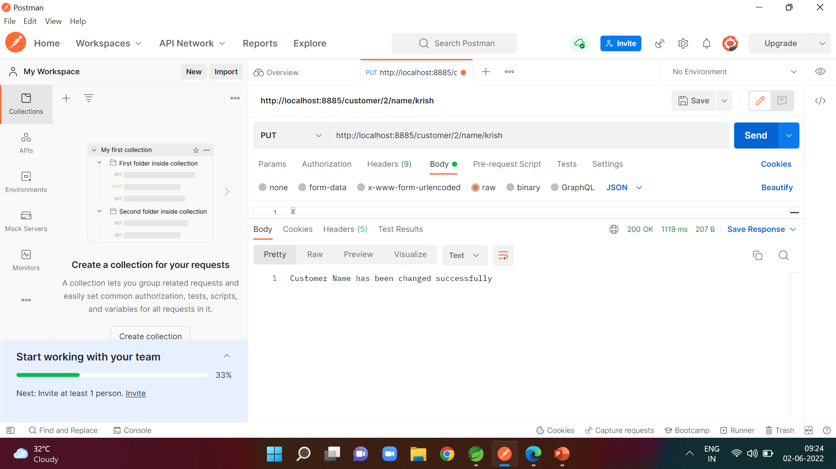
If Customer wants to Change His Name By using PUT method
URL:http://localhost:8885/customer/2/name/krish

Slide 16

if Customer wants to Change His City By using PUT method
URL:http://localhost:8885/customer/4/city/mumbai

Slide 17

if Customer wants to Change His State By using PUT method
URL:http://localhost:8885/customer/4/state/maharashtra

Slide 18

if Customer wants to Change His Phone Number By using PUT method
URL:http://localhost:8885/customer/3/phone/9456386215

Slide 19
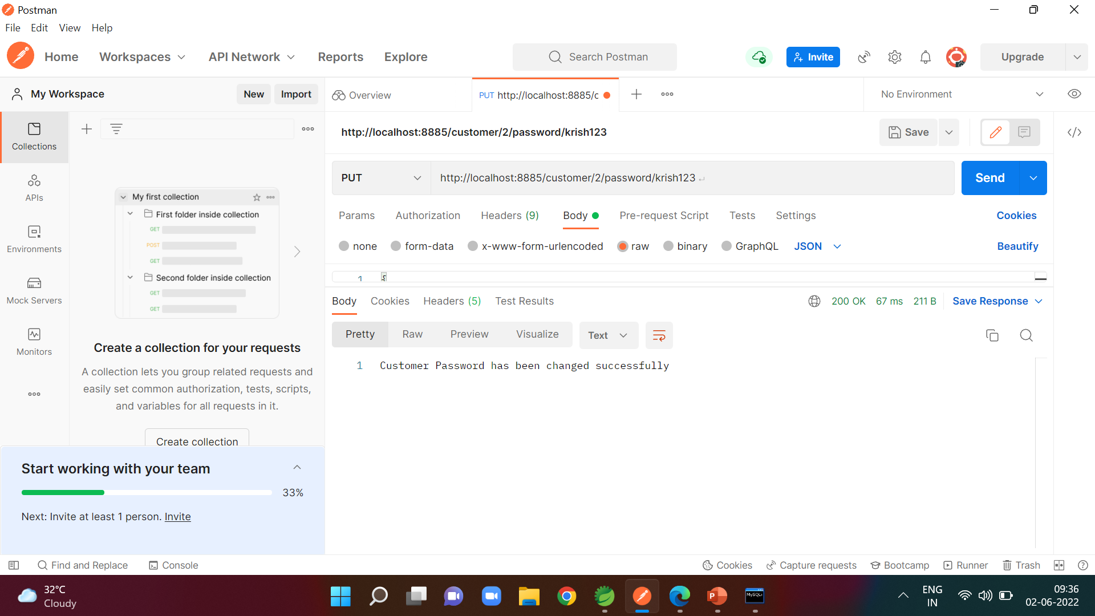
if Customer wants to Change His Password By using PUT method
URL:http://localhost:8885/customer/2/password/krish123

Slide 20
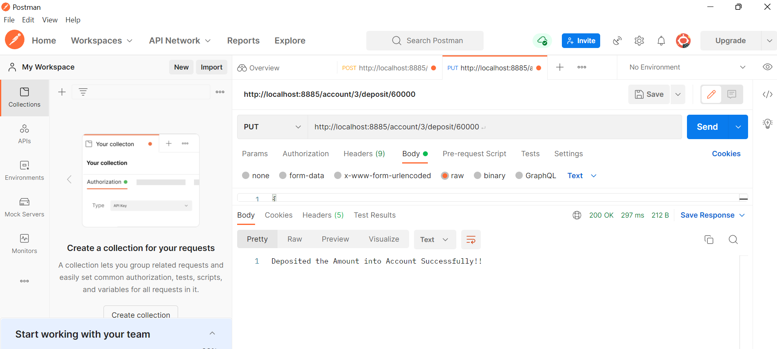
if Account Holder wants to Deposit some money into his Account By using PUT method
URL:http://localhost:8885/account/3/deposit/60000

Slide 21

if Account Holder wants to Withdraw some money into his Account By using PUT method
URL:http://localhost:8885/account/1/withdraw/5000

Slide 22

Account holder wants to transfer money into another account by using PUT method
URL:http://localhost:8885/account/1/transfer/5/2000

Slide 23
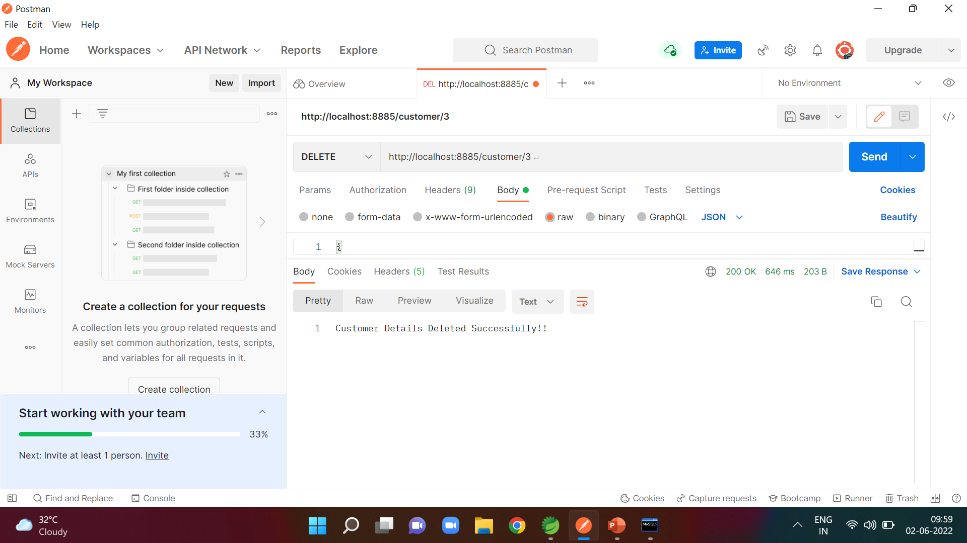
Deleting the customer details based on id By using DELETE method
URL:http://localhost:8885/customer/3

Slide 24
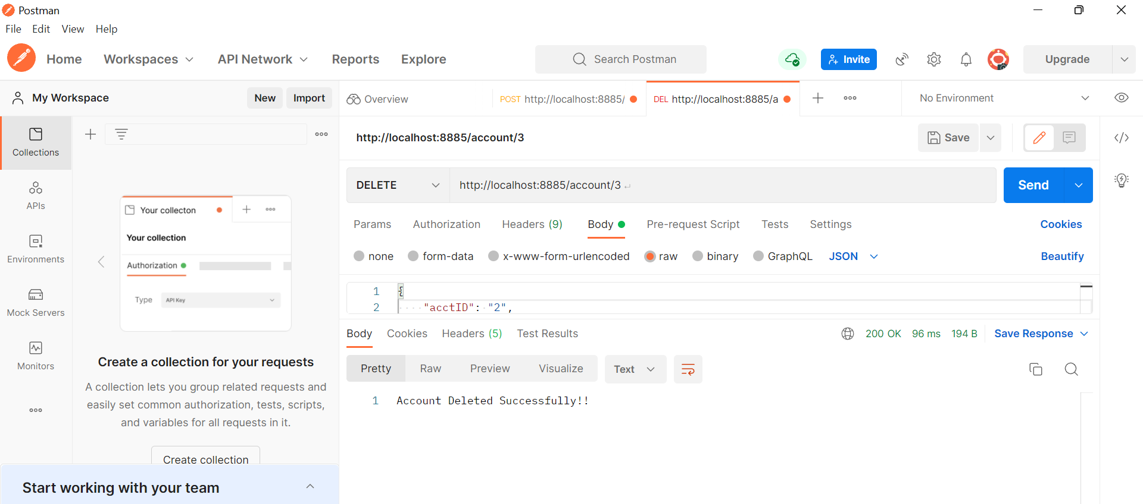
Deleting the account details based on id By using DELETE method
URL:http://localhost:8889/account/3

Slide 25
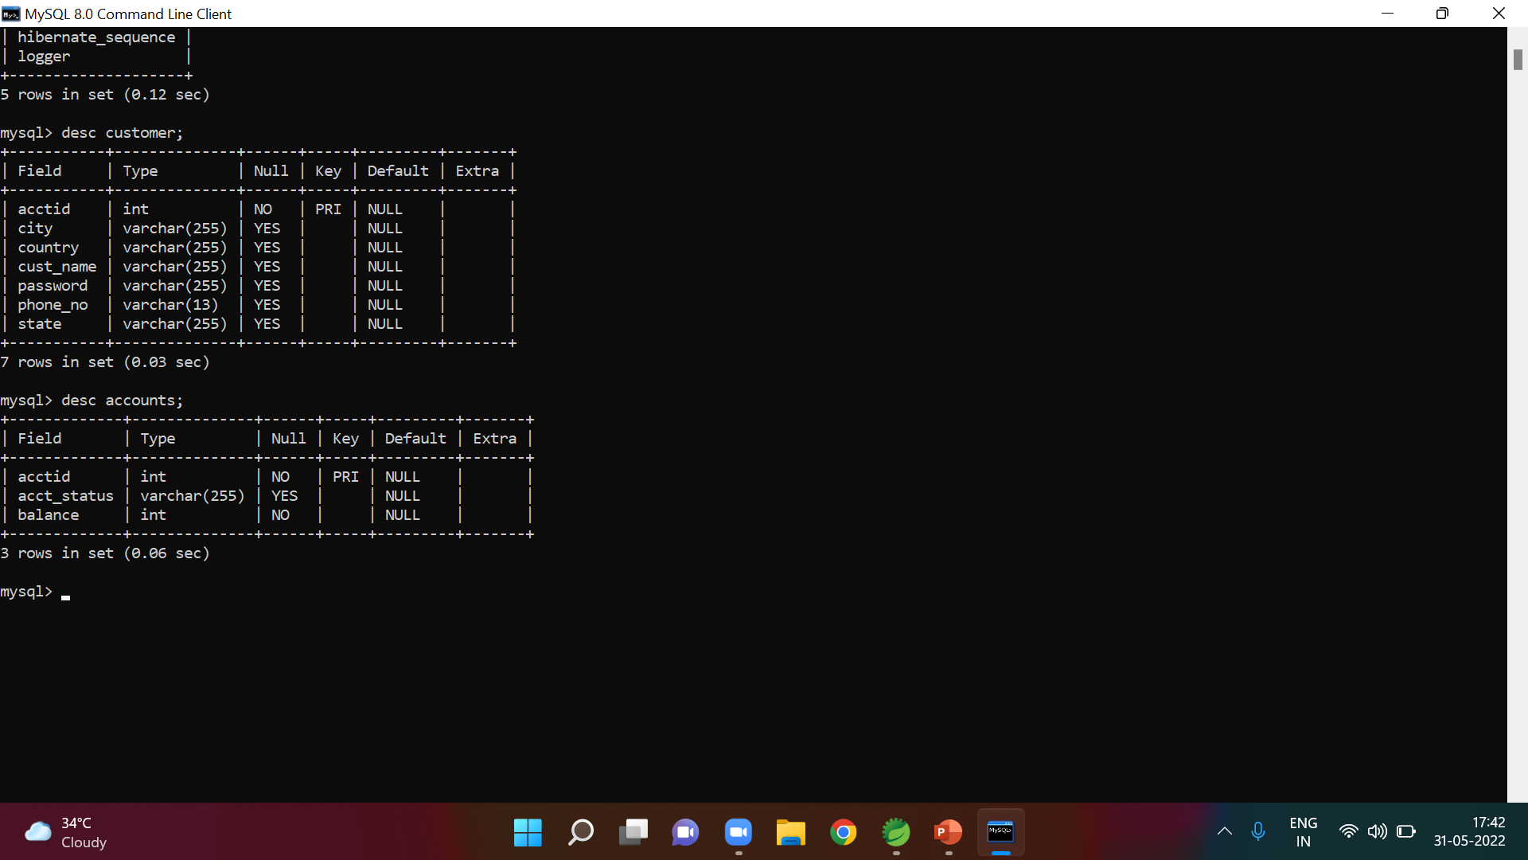
Customer and Account tables in Database :

Slide 26
Conclusion:
This project is developed to nurture the needs of a user in a banking sector by embedding all the tasks of transactions taking place in a bank made Easier to handle.

Slide 27
Thank You

